Slide 1
Reporting
I have always laid emphasis on realisation of efficiency in financial processes and financial systems. With as goal reliable and quick available management information that allows me (and the rest of the company) to react adequate on changes in actuals or budgets.
To achieve this we extracted all data direct from the source (financial systems) with a report writer (SAP Crystal Reports).
To give you an idea how it works in practice I have visualized the process that saves time and how you can describe the database structure.
When you extract the data in the right format it is quite easy to make a flash presentation as showed in sheet 4 (click on several sales persons).
EdG interim
© Copyright 2013 by Erwin de Groot

Slide 2
Reporting
Standard method
Database financial system Company 1
Standard or limited reporting options
Finalised in Excel in certain layout
SAP Crystal Reports
Database financial system Company 1
Data direct in certain layout
Database financial system Company 2
Most important to work fast with SAP Crystal Reports is knowledge of the database structure in the financial (or other) system.
In which table under which field can I find for example GL amount, GL account number, GL date etc.
When this is clear everybody can make quit easily reports.
You can extract data from multiple databases (with the same structure / SQL settings) at the same time in 1 report.
On the next page an example of how I documented this for the Oracle Financials database.
EdG interim
© Copyright 2013 by Erwin de Groot

Slide 3
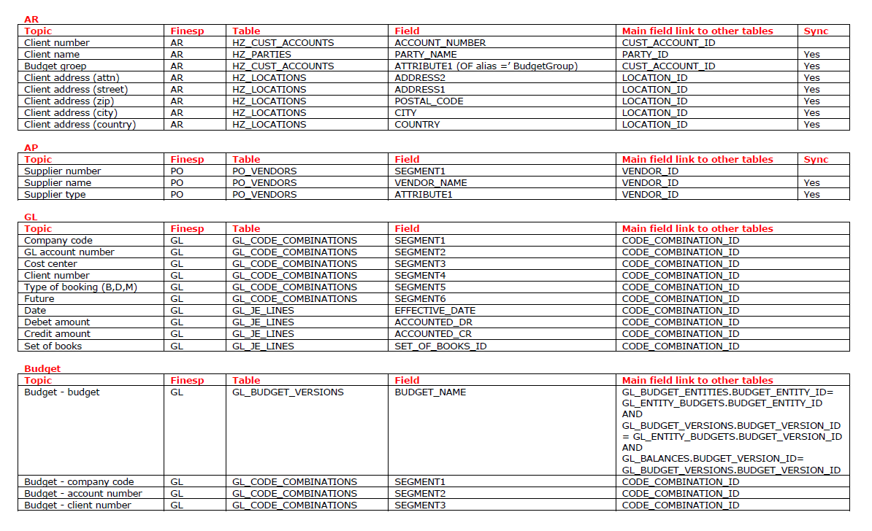
Small example structure Oracle Financials database
EdG interim
© Copyright 2013 by Erwin de Groot

Slide 4
One step further: Crystal Reports Dashboard Design(click on a sales person)
© Copyright 2013 by Erwin de Groot
Notes:
IMPORTANT INFORMATION ABOUT THE VISUALIZATION EMBEDDED IN THIS SLIDE - IF YOU ARE EXPERIENCING DIFFICULTIES,PLEASE READ ON!
This PowerPoint slide includes a Flash visualization exported from Dashboard Design:
1). If you receive the following information message when you open the slide deck, you need to upgrade your version of Adobe.
"Some controls on this presentation cannot be activated. They might not be registered on this computer".
To upgrade Adobe Flash Player on your machine:
a). Close PowerPoint - DO NOT SAVE this slide deck.
b). Using Internet Explorer, install the latest Adobe Flash Player from www.adobe.com
c). Reopen this PowerPoint slide deck.
2). If the design-time thumbnail for the model is not visible, enter and exit Slide Show mode.
3) If you have Microsoft Office 2007, DO NOT save Word documents or PowerPoint presentations that contain Dashboard Design and Presentation Design models as Word Document or PowerPoint Presentation formats. Office 2007 files (pptx and docx formats) do not support embedded Flash files. Save documents and presentation files only as Word 97-2003 Document or PowerPoint 97-2003 Presentation formats.
4). If the visualization shows error code messages (#2048, etc), Flash security restrictions have prevented the embedded content from accessing external data. For more information about allowing visualizations to access external data, see the Adobe Flash Player Security Restrictions section in the Dashboard Design and Presentation Design User Guide.

Slide 5
Summary
Having a good report writer can save a lot of time as you can skip one step in exporting the data from the system.
Usage of it is not limited to only P&L figures.
Report has always the same layout and contains real time data.
It can be used for all data and different data sources as long as there is a “link” between the different databases.
As the data comes directly from the source there should be no difference with the GL when the report is well defined.
I hope I made you more curious and convinced that time can be saved.
I would like to emphasize that I am not only interested in IT.
For me IT is a way to achieve the highest reliability and efficiency in a company.
And there is a big gap between willing and achieving.
EdG interim
© Copyright 2013 by Erwin de Groot

